Slide 1
Analysis of Geolocated Transmitters

Slide 2
Overview
Distances between transmitters.
Patterns related to distances between transmitters.
Location of transmitters.
Bandwidth (MHz) and it’s relation to other transmitter attributes.

Slide 3
Distances Between Transmitters
This is the average distances between the cell cites from the given data. These values are the distance formula of the Longitude and Latitude. After further reading I realized these directional degrees are not proportional but for the purpose of the exercise I think it is fine using this.
Mean: 0.0475729587317
Median: 0.0443550335362

Slide 4
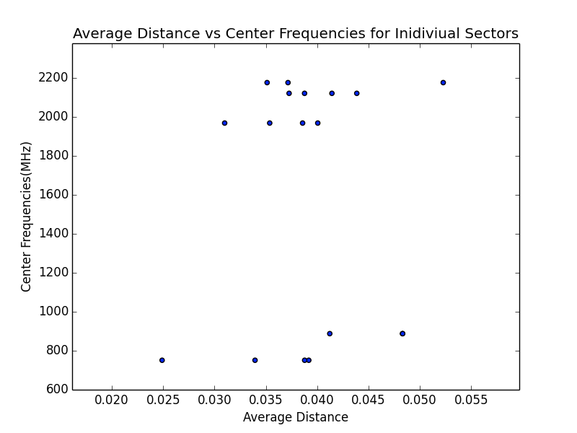
The points that are on the same center frequency line are averages from different sectors.
There is no strong relationship between the frequencies and the average distance between other towers of the same frequency.
I believe Aurora Insight can help companies from placing too many or too little transmitters.

Slide 5
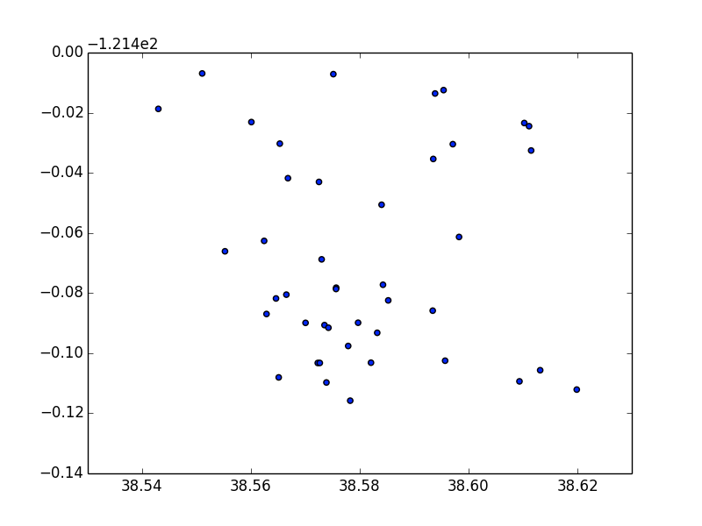
Location of Transmitters
There are more cell sites in some areas in what I assume are more populated. There could also be more natural obstacles like mountains that require a closer network of cell sites.

Slide 6
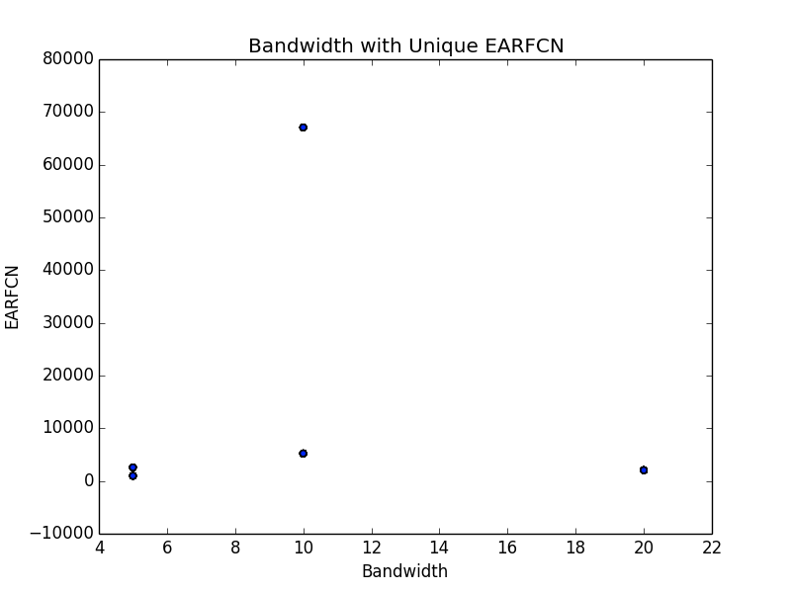
Bandwidth (MHz) and it’s relation to other transmitter attributes.
The EARFCN uniquely identifies the LTE band and carrier frequency. However, I found that each bandwidth also has a unique EARFCN but online I found that they aren’t related. Possibly the bandwidth is related to the frequency which is then related to the EARFCN.

Slide 7
Conclusion
I really thought there would be more correlation between frequencies and distances between transmitters. Like I said in a previous slide maybe this is because of lack of information on where other towers are.
If I were to go back, I would use excel pivot tables. However, Python is fun!

